Slide 1
Wanderlust: A Personalized Travel Planning And Tracking App
Submitted by,
Aadhithya.S ,
Aathikesavan.S,
Anbumani.k,
Ashok.r.

Slide 2
Description
Wanderlust: A Personalized Travel Planning and Tracking App is an innovative mobile application designed to simplify and enhance the travel experience. The app offers a comprehensive suite of features that cater to every stage of a traveler’s journey—from planning and booking to tracking and sharing experiences with wanderlust, users can create personalized travel itineraries based on their preferences, budget, and interests. The app’s AI-powered recommendations suggest destinations, activities, accommodations, and restaurants tailored to each user’s unique taste. Seamlessly integrated with popular travel services, it allows users to book flights, hotels, and transportation directly within the app. One of the standout features of Wanderlust is its trip tracking and real-time journey updates. Users can track their travel progress, log experiences, and document memories through a travel journal, complete with photos and notes. The app also includes budget management tools, helping travellers stay on top of their expenses while traveling, with a built-in currency converter for hassle-free transactions. To enhance the social aspect of travel, Wanderlust lets users share itineraries, collaborate on trip planning, and connect with a global community of fellow travellers. With offline access to essential trip details, emergency info, and local services, wanderlust ensures that users are prepared for anything, even in remote areas. Whether you’re a frequent traveller, a digital nomad, or someone planning a once-in-a-lifetime vacation, wanderlust provides all the tools you need to organize, track, and enjoy your travel experiences like never before. Create an innovative mobile app that helps users plan, organize, and track their travel experiences. Wanderlust will provide personalized recommendations, a seamless itinerary management system, and tools for tracking trips in real-time.

Slide 3
SOURCE CODE:
<?xml version="1.0" encoding="utf-8"?><manifest xmlns:android="http://schemas.android.com/apk/res/android" xmlns:tools="http://schemas.android.com/tools"> <application android:allowBackup="true" android:dataExtractionRules="@xml/data_extraction_rules" android:fullBackupContent="@xml/backup_rules" android:icon="@mipmap/ic_launcher" android:label="@string/app_name" android:supportsRtl="true" android:theme="@style/Theme.TravelApp" tools:targetApi="31">
<activity android:name=".RegisterActivity" android:exported="false" android:label="RegisterActivity" android:theme="@style/Theme.TravelApp" /> <activity android:name=".SingaporeActivity" android:exported="false" android:label="@string/title_activity_singapore" android:theme="@style/Theme.TravelApp" />

Slide 4
<activity android:name=".SingaporeActivity" android:exported="false" android:label="@string/title_activity_singapore" android:theme="@style/Theme.TravelApp" /> <activity android:name=".ParisActivity" android:exported="false" android:label="@string/title_activity_paris" android:theme="@style/Theme.TravelApp" /> <activity android:name=".BaliActivity" android:exported="false" android:label="@string/title_activity_bali" android:theme="@style/Theme.TravelApp" /> <activity android:name=".MainActivity" android:exported="true" android:label="@string/app_name" android:theme="@style/Theme.
<activity android:name=“.LoginActivity” android:exported=“true” android:label=“@string/app_name” android:theme=“@style/Theme.TravelApp”> <intent-filter> <action android:name=“android.intent.action.MAIN" />

Slide 5
<category android:name="android.intent.category.LAUNCHER" /> </intent-filter> </activity> </application></manifest>
Build.gradle
buildscript { ext { compose_ui_version = '1.2.0' }}// Top-level build file where you can add configuration options common to all sub-projects/modules.plugins { id 'com.android.application' version '7.4.1' apply false id 'com.android.library' version '7.4.1' apply false id 'org.jetbrains.kotlin.android' version '1.7.0' apply false}

Slide 6
colors.xml
<?xml version="1.0" encoding="utf-8"?><resources> <color name="purple_200">#FFBB86FC</color> <color name="purple_500">#FF6200EE</color> <color name="purple_700">#FF3700B3</color> <color name="teal_200">#FF03DAC5</color> <color name="teal_700">#FF018786</color> <color name="black">#FF000000</color> <color name="white">#FFFFFFFF</color></resources>
Compiler.xml
<?xml version="1.0" encoding="UTF-8"?><project version="4"> <component name="CompilerConfiguration"> <bytecodeTargetLevel target="11" /> </component></project>

Slide 7
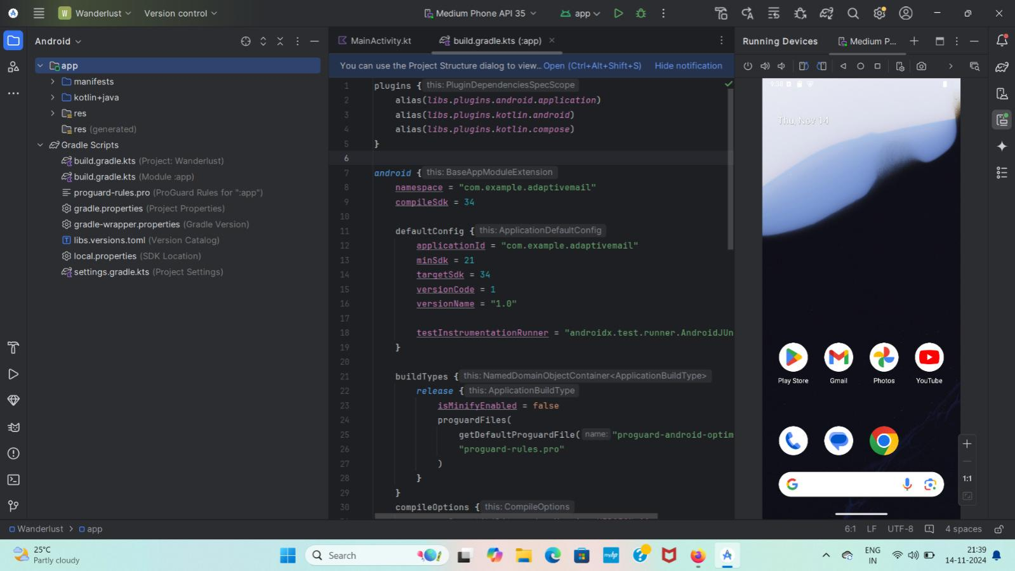
OUTPUT

Slide 8
